Slide 1

Mathematical modelling and simulation of a collision between two solids
Third group assignment
Andrea Somma, Giovanni Tomaciello, Paolo Zagardo

Slide 2
INDEX
Cut off Method
Linked Cell Method
Periodic Boundary Conditions
Fourth order symplectic algorithm
final result

Slide 3

THE CUT OFF METHOD

Slide 4
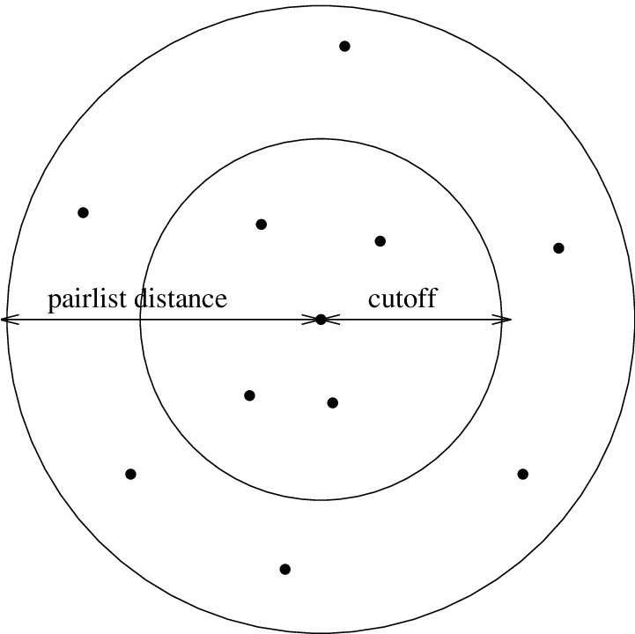
The cut-off method is a common technique used to approximate the interactions between atoms or molecules.
When simulating interparticle interactions, the calculation of forces between every pair can be computationally expensive, especially for large systems.
The cut-off method considering only interactions that are within a certain distance of each other, while disregarding interactions beyond this distance.

Slide 5
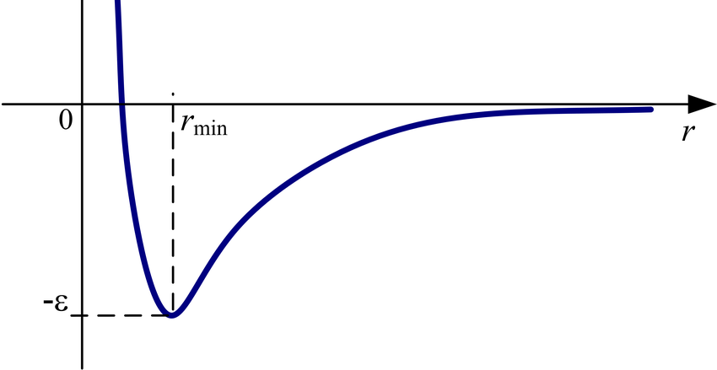
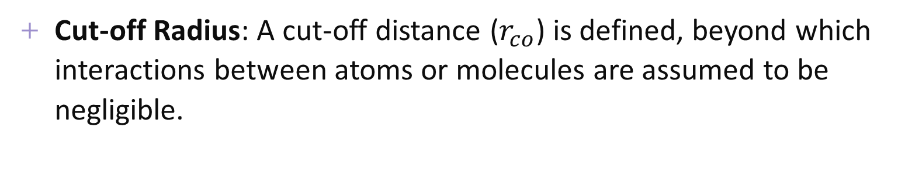
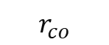
Cut-off Radius: A cut-off distance ($r_{co}$) is defined, beyond which interactions between atoms or molecules are assumed to be negligible.
$$r_{co}$$
Pairwise Interactions: During the simulation, for each atom or molecule, only interactions with neighboring atoms or molecules within the cut-off radius are calculated. This significantly reduces the number of pairwise interactions that need to be computed.

Slide 6
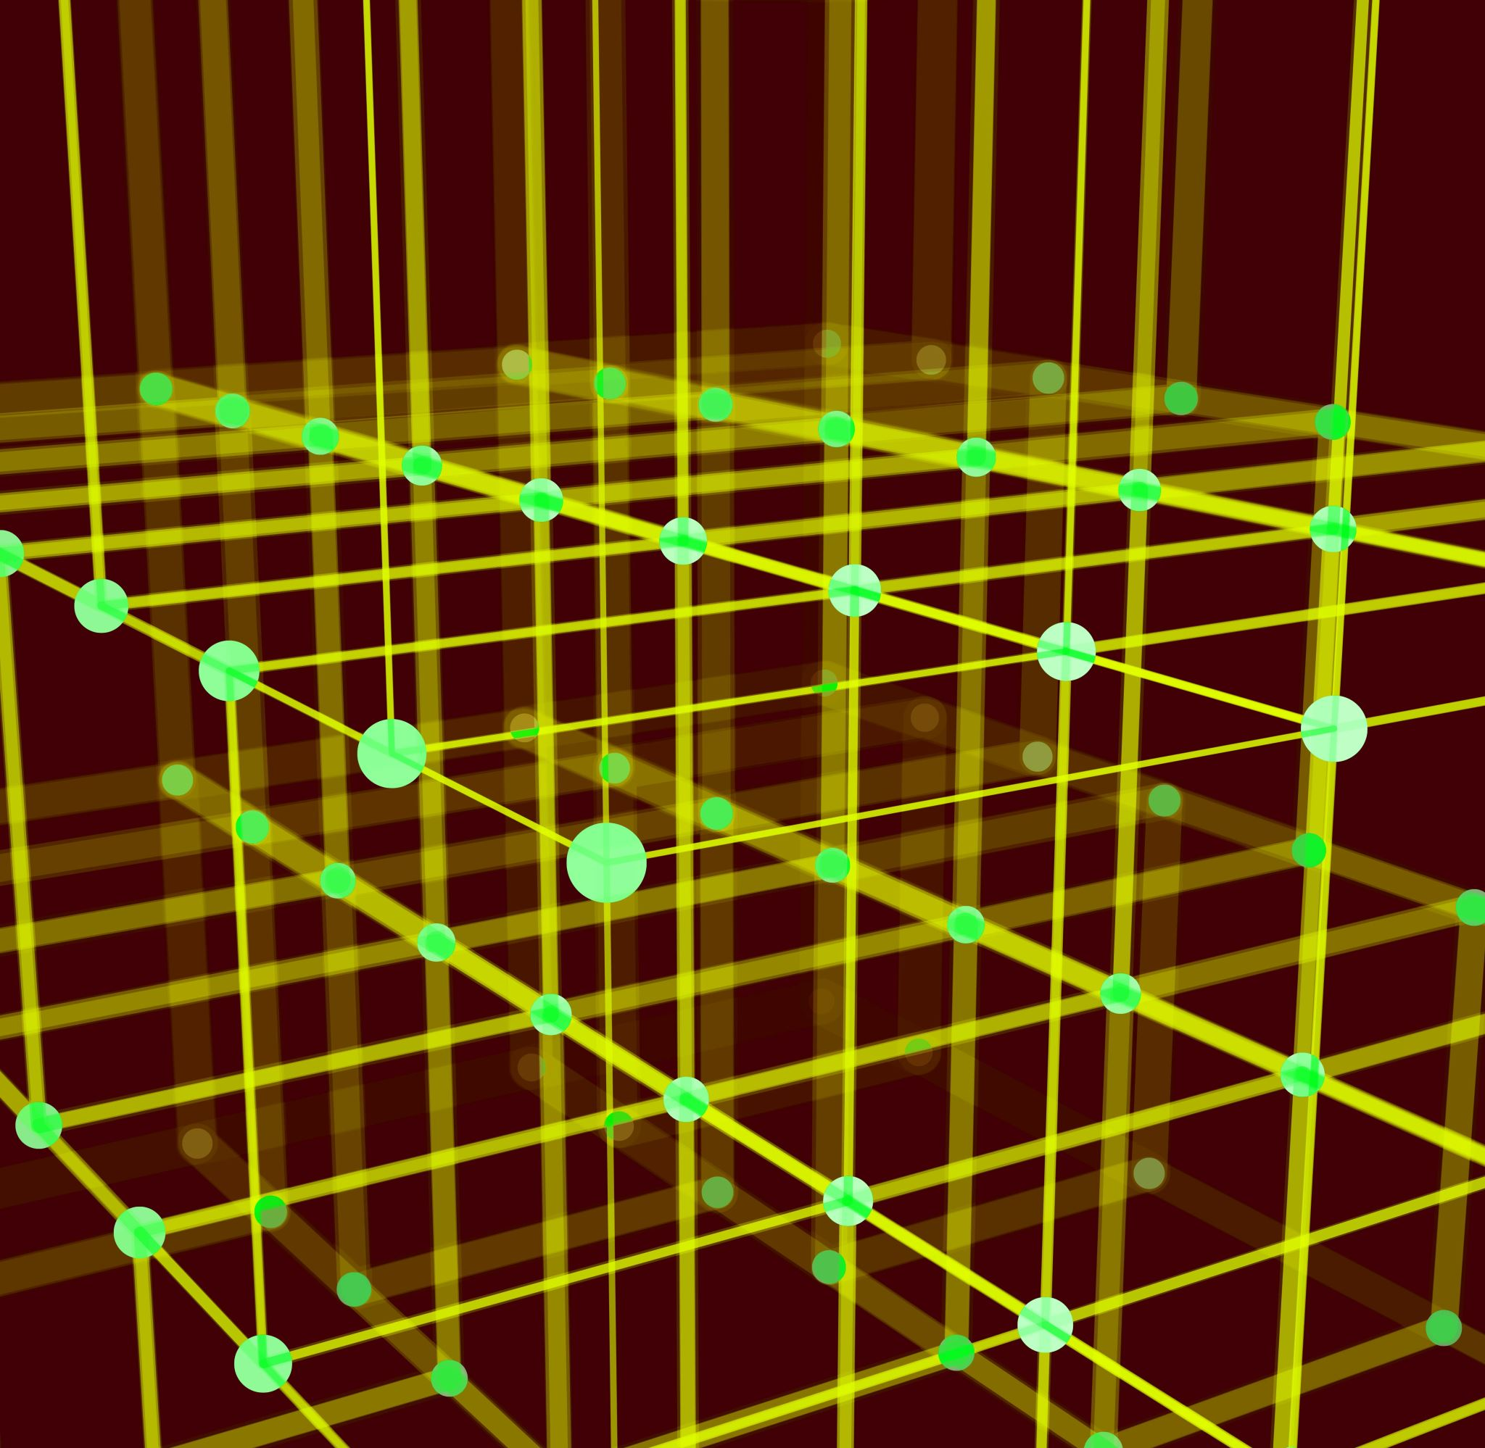
THE LINKED CELL METHOD

Slide 7

THE LINKED CELL METHOD
Its primary purpose is to efficiently locate neighboring particles within a specified interaction range.
How does it work?
Spatial Division: The simulation domain is divided into a regular grid of cells. Each cell has a defined size, typically equal to or slightly larger than the interaction range of the particles being simulated.
$$r_{co}$$

Slide 8
Particle Assignment: each particle is then assigned to the cell containing its spatial coordinates. This assignment is done by determining which grid cell the particle belongs to based on its position.
Linked Lists: in addition to assigning particles to cells, each cell maintains a list of all particles contained within it.
Neighboring Cells: to efficiently locate neighboring particles within a specified interaction range, each cell maintains references to neighboring cells.
Interaction Calculation: when calculating interactions between particles, each particle only needs to consider interactions with particles within its own cell and neighboring cells within the interaction range. This significantly reduces the number of pairwise interactions that need to be computed.

Slide 9

PERIODIC BOUNDARY CONDITIONS

Slide 10
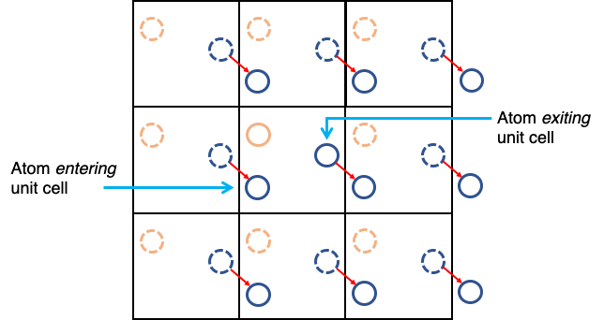
PERIODIC BOUNDARY CONDITIONS
Particles leaving one edge of the simulation cell re-enter from the opposite edge, mimicking an infinite system, thus allowing simulations to represent bulk properties accurately without edge effects.

Slide 11
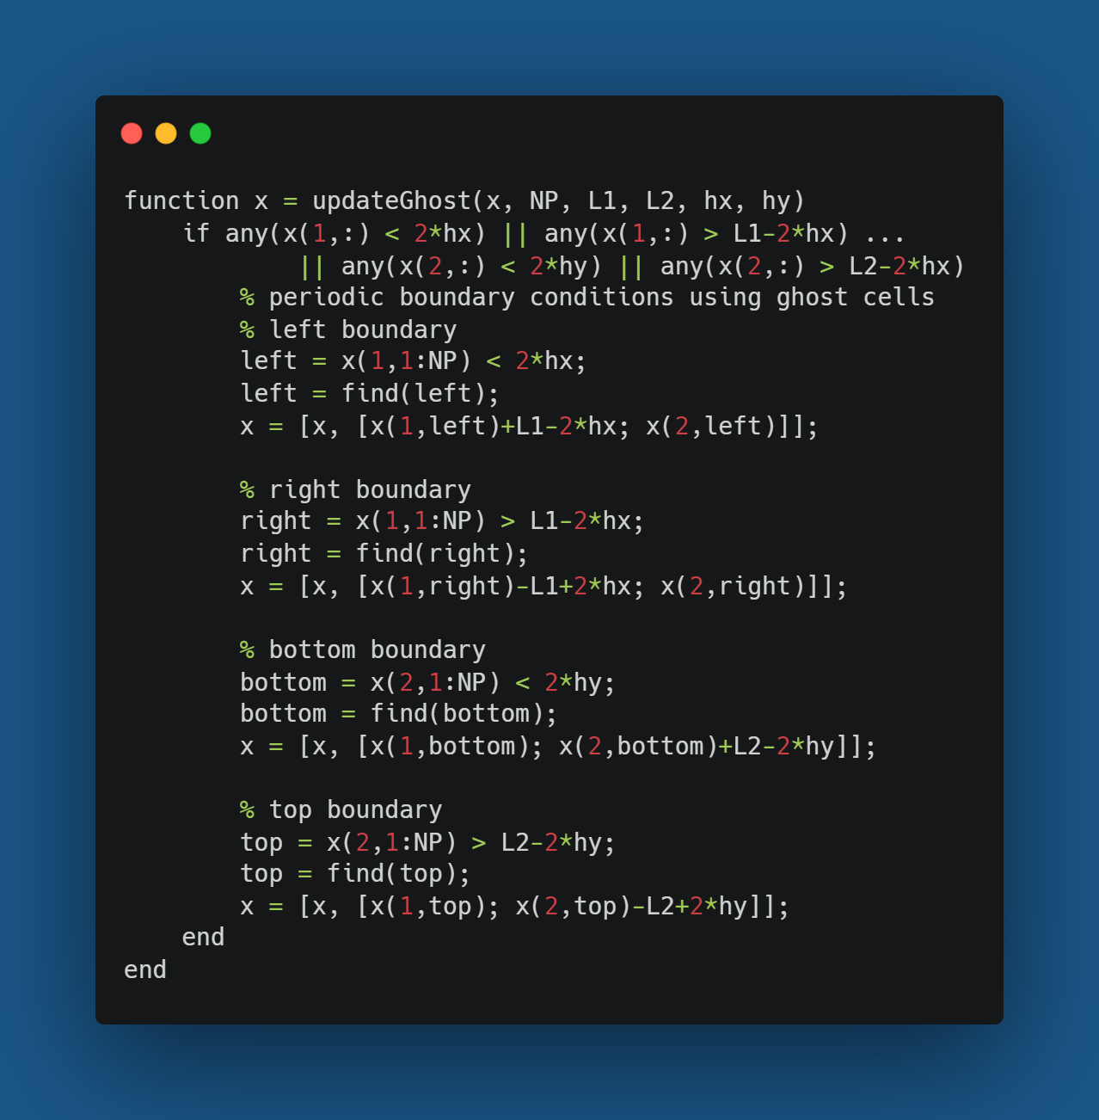
Ghost particles are used to simulate the presence of particles across the boundary

Slide 12
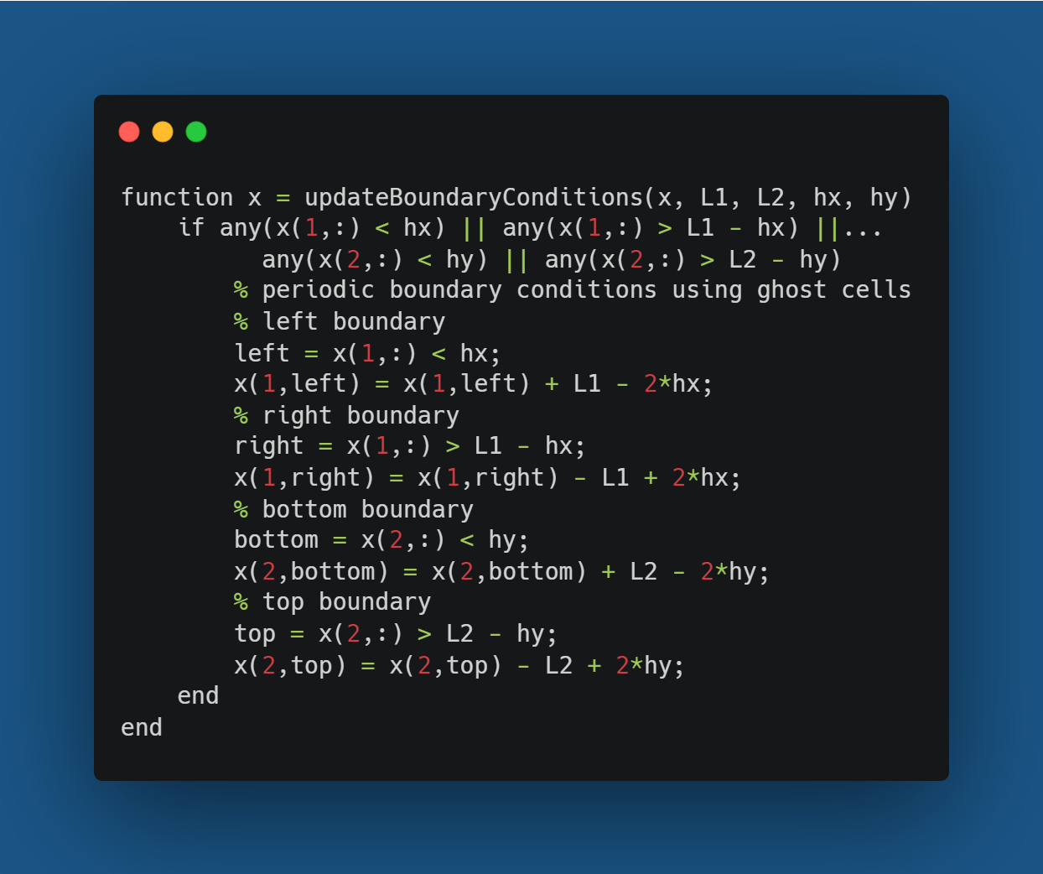
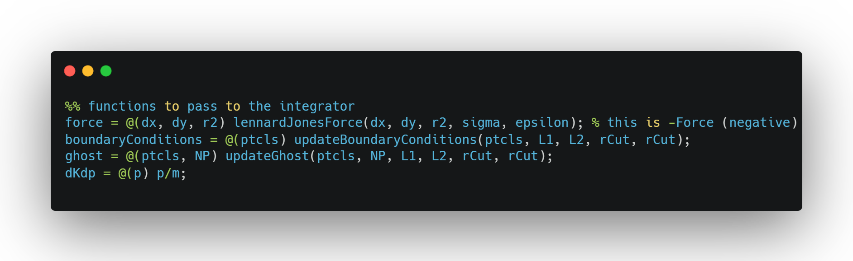
Boundary condition are set to periodic, but can be easily modified with the modular setting of the script

Slide 13
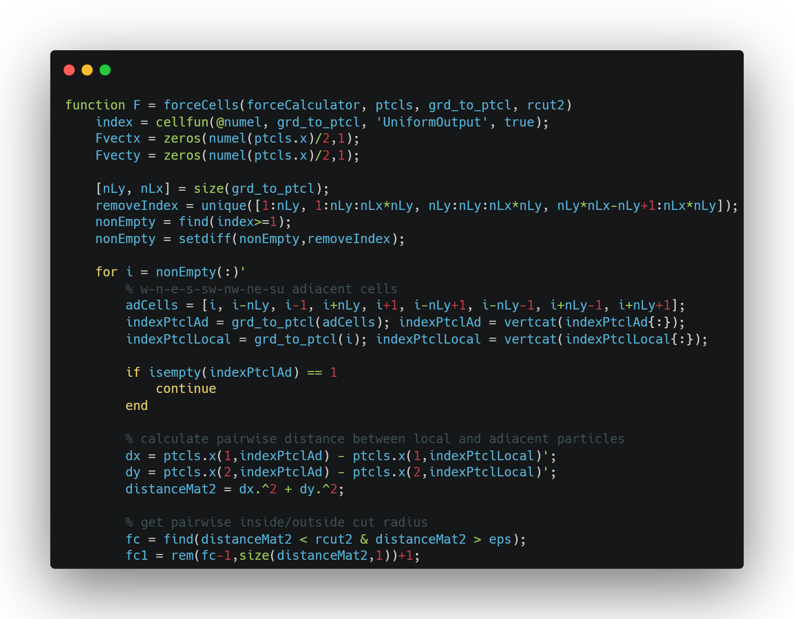
Here is the linked cell algorithm.

Slide 14
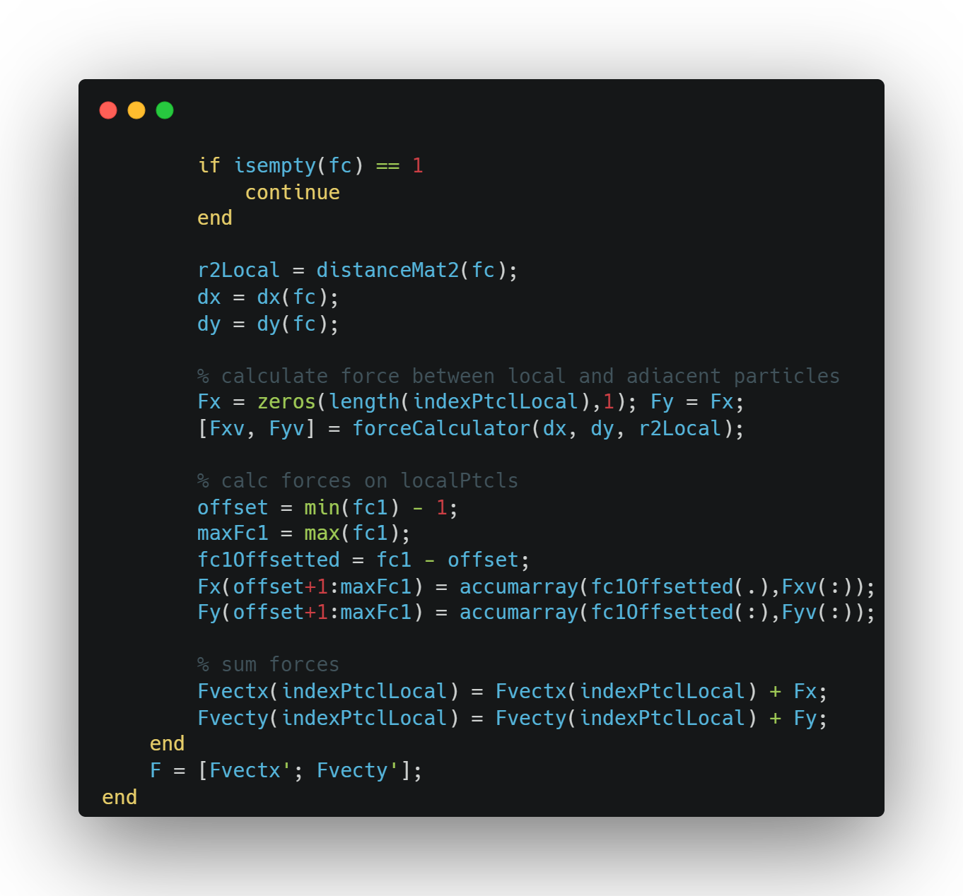
Here is the linked cell algorithm.

Slide 15
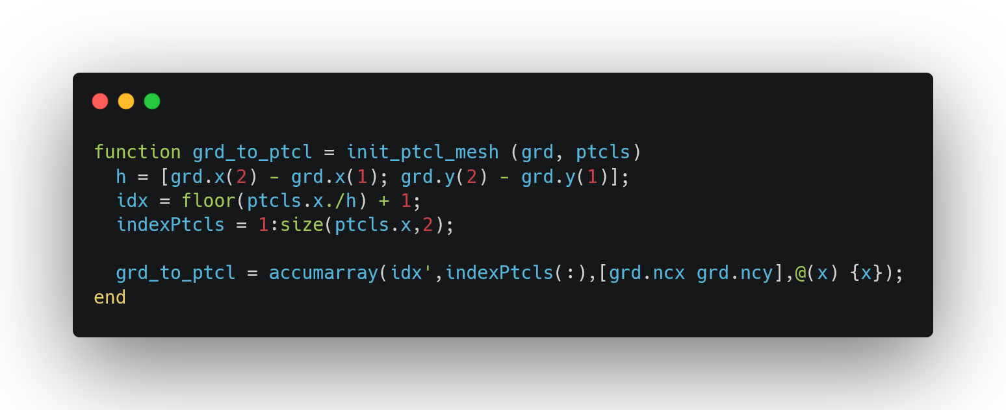
The cell matrix is updated using accumarray to improve the speed of the function with a little trick

Slide 16
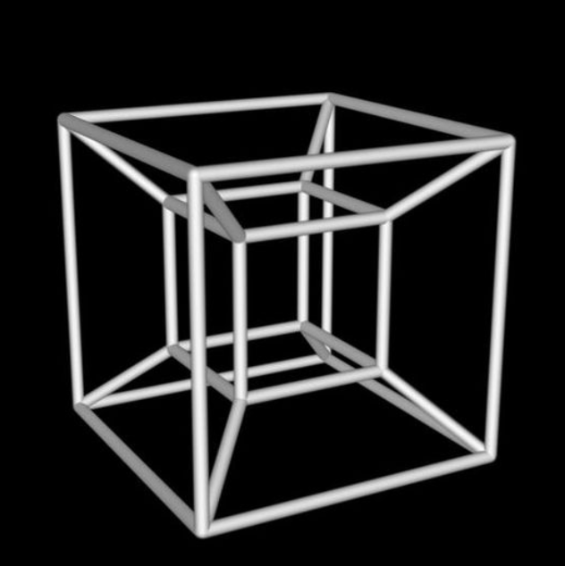
Not only velocity verlet... FOURTH ORDER SYMPLECTIC ALGORITHM

Slide 17
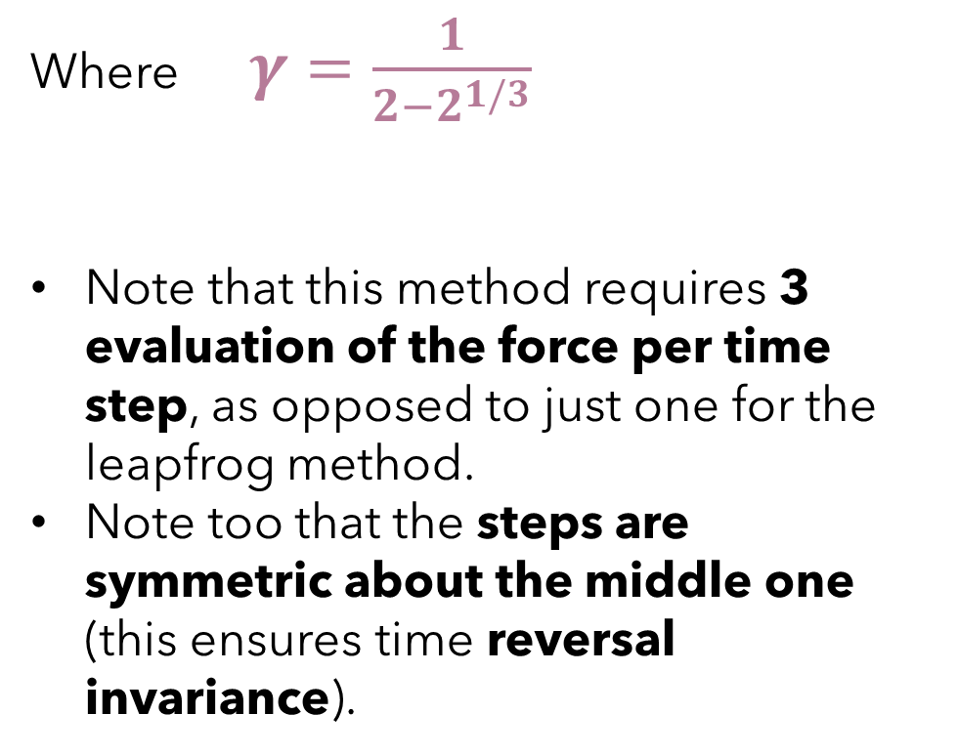
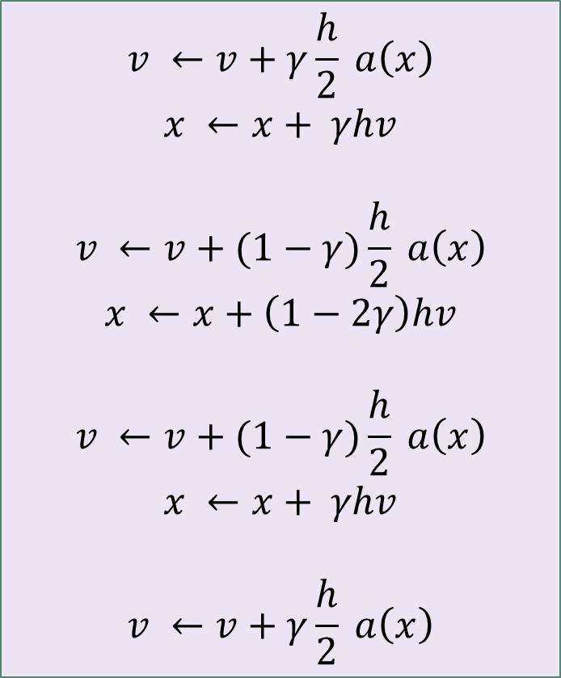
The simplest higher order symplectic algorithm is that of E. Foster and R.D. Ruth:
$$v ←v+γ\frac{h}{2} a\left(x\right)$$
$$x ←x+ γhv$$
$$v ←v+(1−γ)\frac{h}{2} a\left(x\right)$$
$$x ←x+\left(1−2γ\right)hv$$
$$v ←v+(1−γ)\frac{h}{2} a\left(x\right)$$
$$x ←x+ γhv$$
$$v ←v+γ\frac{h}{2} a\left(x\right)$$
Where $γ=\frac{1}{2−2^{1/3}}$
Note that this method requires 3 evaluation of the force per time step, as opposed to just one for the leapfrog method.
Note too that the steps are symmetric about the middle one (this ensures time reversal invariance).

Slide 18

FINAL RESULTS

Slide 19
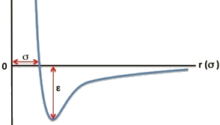
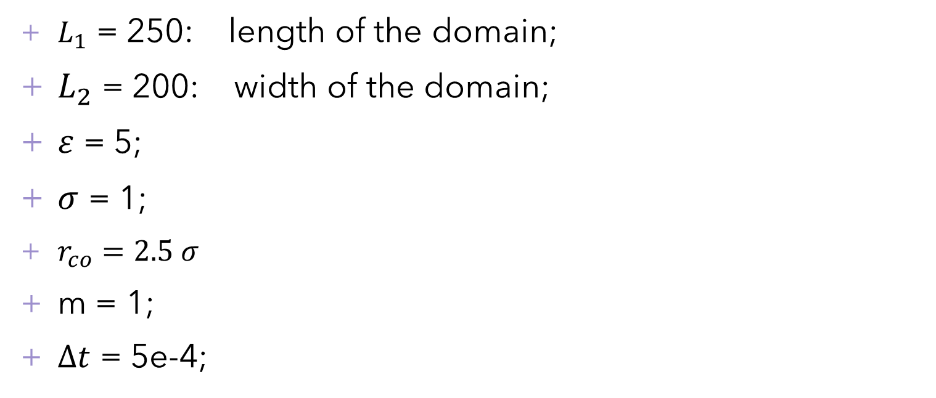
PARAMETERS OF THE SIMULATION
$L_{1}$ = 250: length of the domain;
$L_{2}$ = 200: width of the domain;
$ε$ = 5;
$σ$ = 1;
$r_{co}=2.5 σ$
m = 1;
$∆t$ = 5e-4;
Lennard-Jones Potential

Slide 20
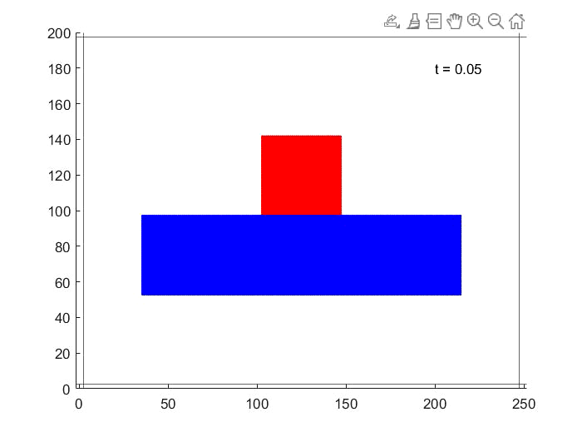
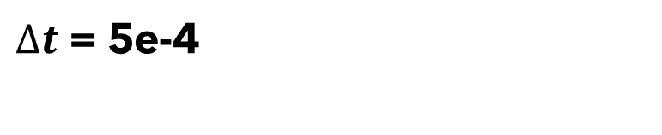
Forest
$∆t$ = 5e-4

Slide 21
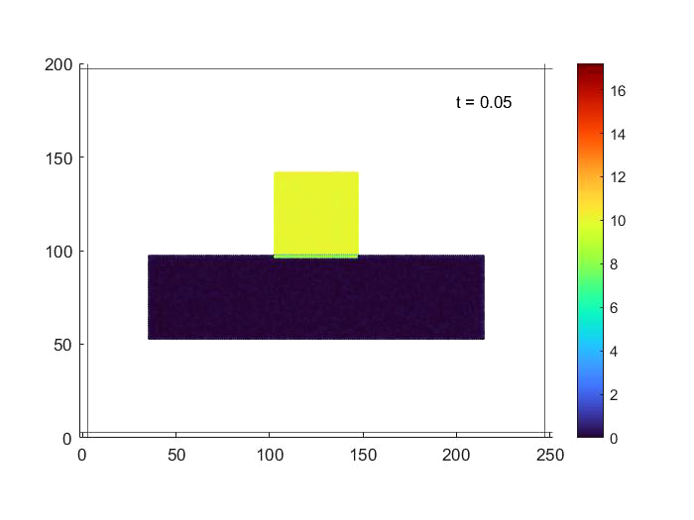
Forest
$∆t$ = 5e-4

Slide 22

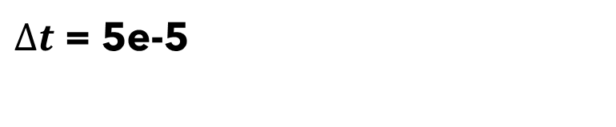
Velocity Verlet
$∆t$ = 5e-5

Slide 23

Velocity Verlet
$∆t$ = 5e-5

Slide 24
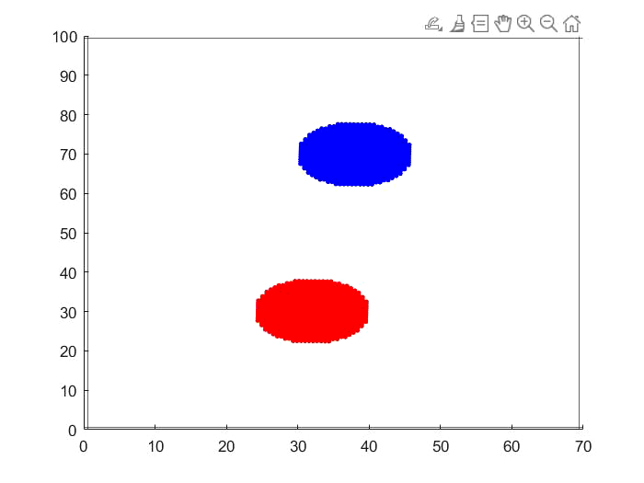

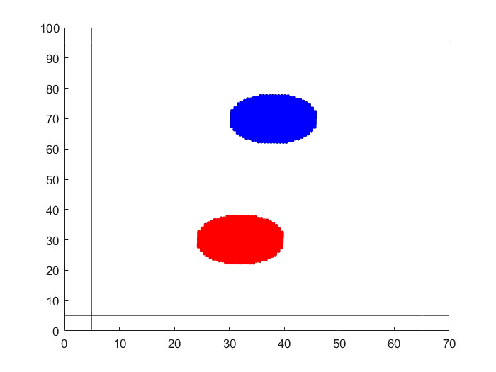



A little plus ;)
$$r_{co}=1.25 σ$$
$$r_{co}=2.5 σ$$
$$r_{co}=10 σ$$

Slide 25
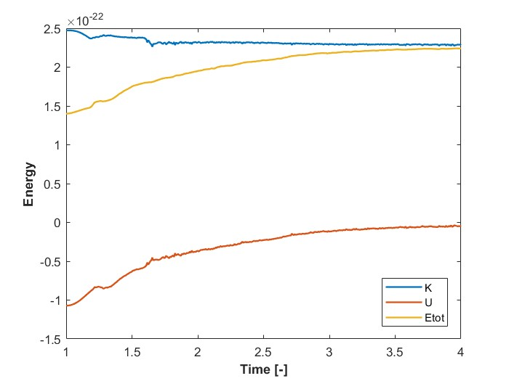
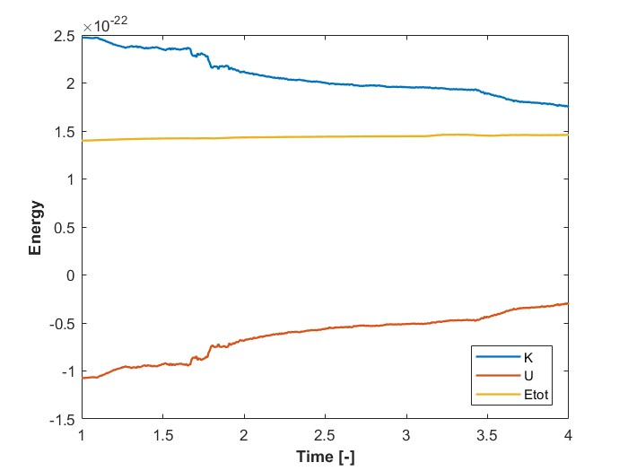
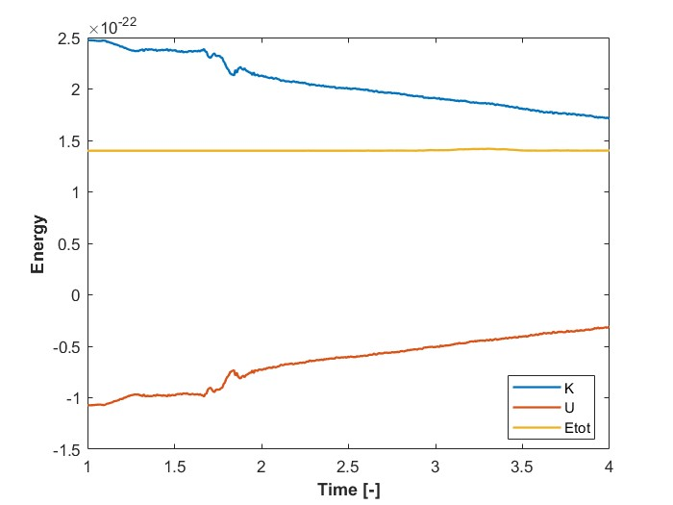
A little plus ;)
$$r_{co}=1.25 σ$$
$$r_{co}=2.5 σ$$
$$r_{co}=10 σ$$

Slide 26

Thanks for the attention

